Slide 1


java
Application
Construction engine for
Organisations and
Business
What is
A webbased Runtime and Application development Platform.

Slide 2
Why ?
There is a need for a comprehensive web based development.
Licenses must retain value for money, i.e no extra software component costs but utilization of Standard software components.
In a 7*24 Business Deployment times that exceed 1 hour are not acceptable.

Slide 3






Modularity
Core Engine & Runtime
Applications
Modules

Slide 4
Core Engine & Runtime
Features:
Simple, fast and qualitatively high standard application development.
Run time environment for web based applications.
Hot deployment of applications.
Multiple Database (Datasource) Access.
Full scalability.
Ad-hoc Reporting.
Integration of manually created functions (e.g. Screens).

Slide 5
Runtime Architecture: 3 Layers
Client Layer/
Presentation Layer
Browser (Internet Explorer 5.x, 6.x, Firefox 1.0 and greater)
http://vudb0007:8080/jacob/index.jsp
WebSphere, WebLogic, Tomcat
Middle Layer/
Business Layer
jACOB Runtime
(jacob.war = Standard Web application)
jACOB Application
Database
Data Layer
Oracle
Oracle
Legend
jACOB
Third Party
Customizable

Slide 6
Runtime Architecture: Components (1.2.2005)
Browser (Internet Explorer, Firefox, etc.)
Client
Server
HTTP / HTML
jACOB Scheduler
WebSphere, WebLogic, Tomcat
Hook
Hook
jACOB Scripts
jACOB Scripts
API
API
DeploymentComponent
API
API
Hook
Data Access Component
Ad-hoc Report Component
GUI Library
Notification Component
jACOB Scripts
Interface
Interface
jACOB
Report
XML
Email
Fax
SMS
Oracle Datasource
MS SQL
Datasource
Application
A
Applic ation
B
A 1.0
.jacapp
Legend
Oracle
MS SQL
A 1.1
.jacapp
B 1.3
.jacapp
jACOB
Third Party
Customizable
Oracle
Oracle
Oracle
Oracle

Slide 7
Runtime Architektur: Komponenten (Roadmap)
Browser (Internet Explorer, Firefox, etc.)
Java Application Client
Client
Java Applet
Server
HTTP / HTML
RMI
jACOB Scheduler
WebSphere, WebLogic, Tomcat
Java GUI Server
Hook
Hook
jACOB Scripts
jACOB Scripts
API
API
DeploymentComponent
API
API
API
Hook
Data Access Component
Ad-hoc Report Component
GUI Library
Workflow Component
Notification Component
jACOB Scripts
Interface
Interface
Interface
jACOB
Report
XML
Interface
Interface
Email
Fax
SMS
Oracle Datasource
MS SQL
Datasource
DB2
Datasource
Application
A
Third Party
Workflow Engine
jACOB
Workflow Engine
Application
B
A 1.0
.jacapp
Legend
Oracle
MS SQL
DB 2
A 1.1
.jacapp
B 1.3
.jacapp
jACOB
Third Party
Customizable
Oracle
Oracle
Oracle
Oracle
Oracle
Oracle

Slide 8

Access and Abstraction of Data – Particularly (but not exclusively) for Data in relational Databases.
Support of commercial and Open Source Databases
Simultaneous access to different data sources.
Generally applicable QBE (Query By Example) Functionality.
Data Cacheing per user.
Transaction support.
General access to administration- and monitoring data for control and monitoring of individual components.

Slide 9
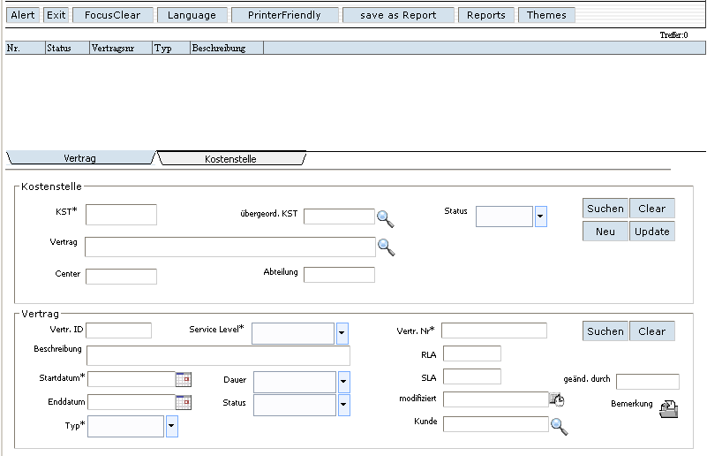
Data Access: Applications with different Data Sources
MyApplication
MS SQL
Contract
Admin
Oracle
Financials

Slide 10
Data Access: Supported Databases
Currently:
Oracle 8.1.7, 9.x and higher (Oracle 8.0.5 and lesser with restrictions)
MS SQL Server 7, 2000 and higher
HSQL
Planned, i.e. as required:
IBM DB2 and IBM Cloudscape
mySQL
PostgreSQL
Sybase

Slide 11


Creation of ad-hoc reports per user access and/or per application programming.
Save and reopening of reports in XML format.
Creation of „on-Screen“ reports and export to Excel.
Client-independant library of GUI-based functions
(e.g. opening a dialog window).

Slide 12

Deployment of (different) applications.
Provide application versions (designs).
Application design support in Quintus format
for temporary parallel operations.
Hot deployment of new functions/versions.
Simultaneous operation of different applications and
or different versions of the application.
Example: A new version of a design can be placed in a real life operational environment whereby at first this new version is only accessible for a limited number of users.

Slide 13
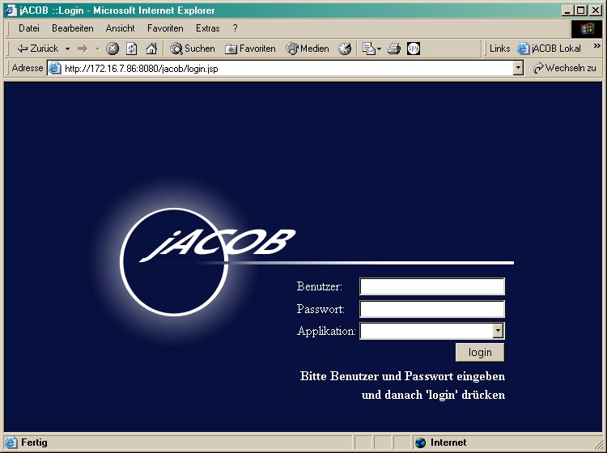
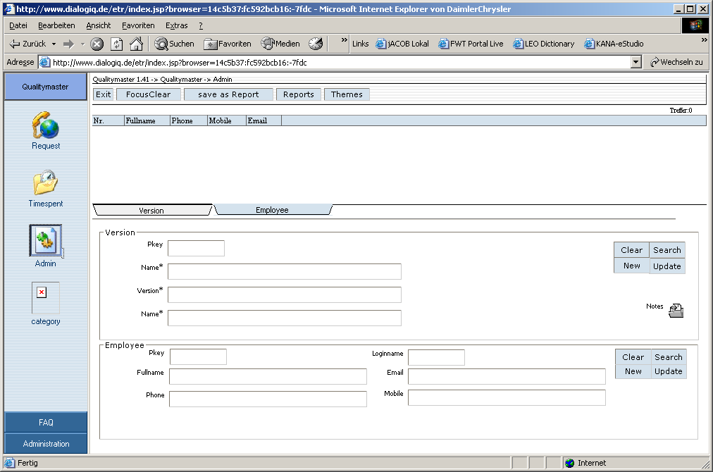
jACOB Installation (Overview)
(Assumption: No database reconfiguration required)
Install jACOB Engine as web application and configure jACOB internal
database as JNDI data source
Web Server
(Websphere, WebLogic,
Tomcat, ..)
Step 1:
jacob
.war
Login
Login as a Admin into jACOB Admin Console
jACOB
Admin
Console
Step 2:
Deployment
Deploy/install new jACOB application
jACOB
Admin
Console
Step 3:
Configuration
When desired, configure new jACOB application
jACOB
Admin
Console
Step 3.1:
Login
Login into the new application ...
new
jACOB
Application
Step 4:

Slide 14
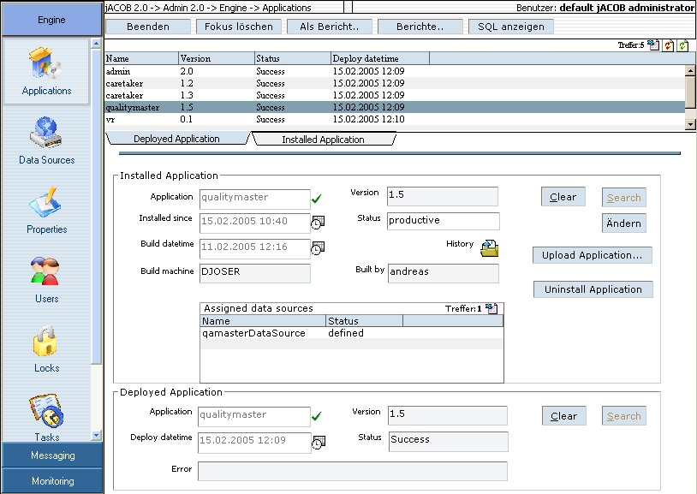
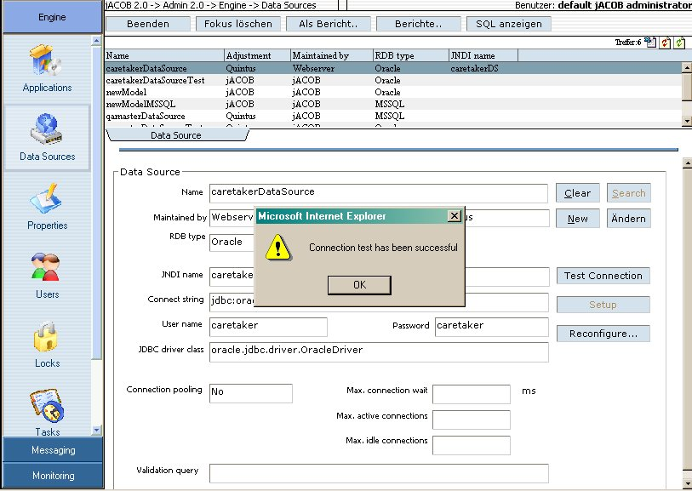
jACOB Application Deployment in Detail
(all done by means of jACOB Admin Console!)
1. Upload new application module (.jacapp).
2. Application will be unpacked, installed
and set into “inactive” status. Required
data sources will be displayed.
3. Define required data sources. To check correct
definition the data sources could be tested.
4. Setup required data sources or reconfigure
existing data sources if needed.
5. Switch status of application to “test” or
“productive”.
6. Login into new deployed application.

Slide 15
Architecture of an application module
Application.jacapp
JAR- resp. ZIP-Format
XML-Format
Application.jad
Data structure
Screens
etc.
Java Class-Format
Business Logic
Hooks at
Data level
Scheduled tasks
Entry points
Hooks at
GUI level
Authentification
JACAPP = jACOB Application

Slide 16
jACOB Admin Console Functionality
Deployment and administration of jACOB applications.
Definition and maintenance of data source, e.g. set-up and reconfigure functionality
Configuration of jACOB core engine and applications by means of properties on 3 levels (engine-, application- and user-level).
Inspection of user sessions, record locks, scheduled tasks, reports and jAN (jACOB application notificator) messages.
Monitoring of time consuming SQL queries to find performance bottlenecks on database layer.
Monitoring of memory usage and system processes.

Slide 17
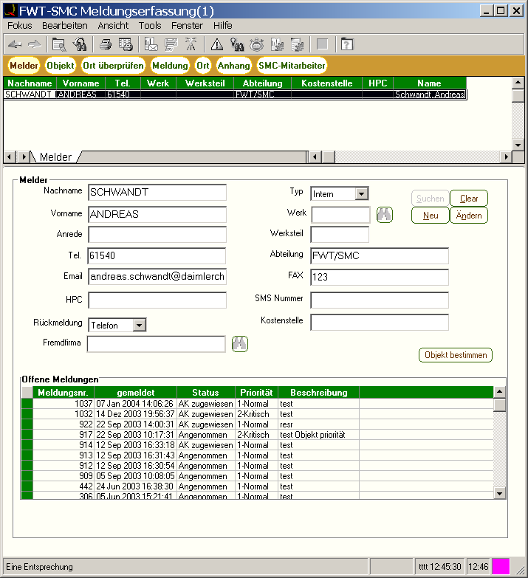
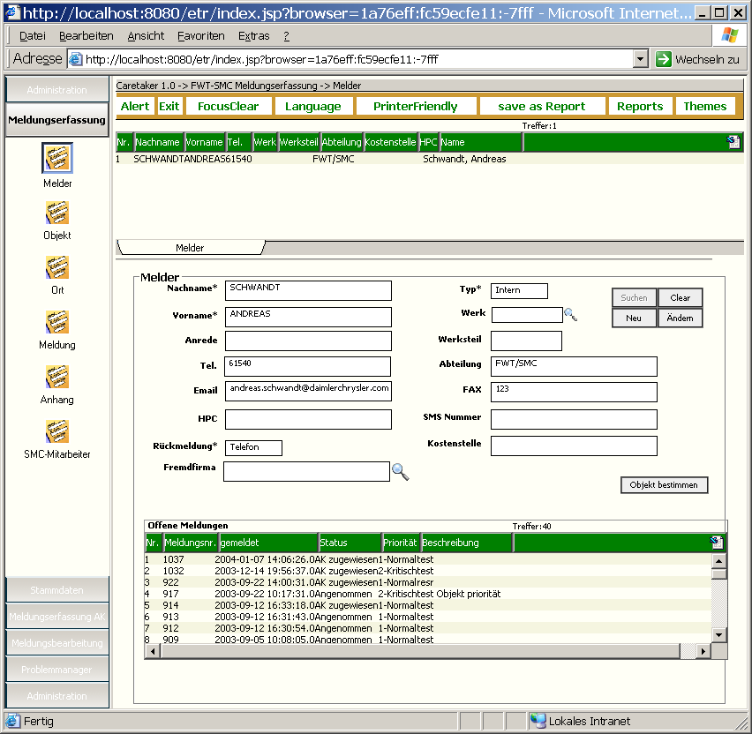
Migration to jACOB 1
now
(Avaya Fat-Client)
after Migration
(jACOB Thin-Client)

Slide 18
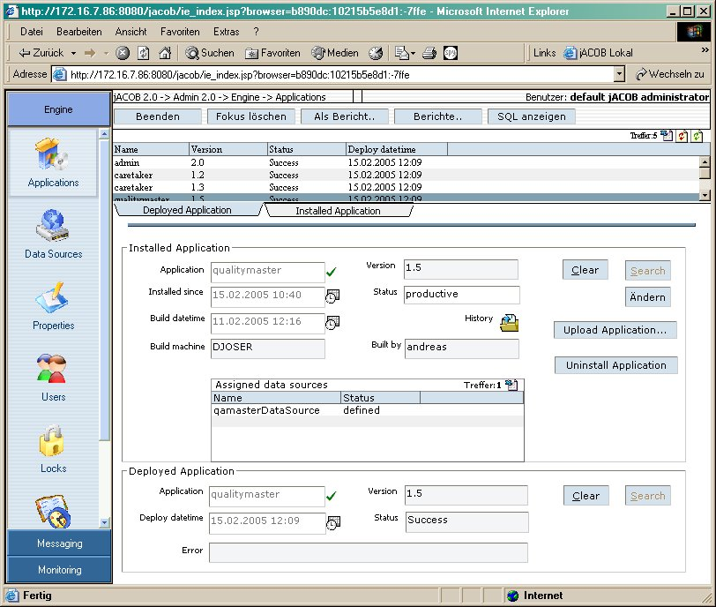
Migration to jACOB 2A (switch to JAD)
Data structure,
Screens
(ADL/ADF)
Business Logic
(Q-Scripte)
Application
Database
now
(Avaya Fat-Client)
Tool
Manual
migration not
necessary!
after Migration
(jACOB Thin-Client)
Data structure,
screens (JAD)
Business Logic
(Java-Hooks)
Application
Database
jACOB Build Process
jACOB Admin Console
application.jacapp
Hot deployment!
JAD = jACOB Application Design Format

Slide 19
Migration to jACOB 2A (switch to JAD)
Advantages:
Using full functionality of jACOB Designer.
Using full functionality of jACOB Runtime.
Disadvantages:
?

Slide 20
Migration to jACOB 2B (keep ADL/ADF)
Data structure,
Screens
(ADL/ADF)
Business Logic
(Q-Scripte)
Application
Database
now
(Avaya Fat-Client)
Manual
migration not
necessary!
after Migration
(jACOB Thin-Client)
Business Logic
(Java-Hooks)
Application
Database
jACOB Build Process
jACOB Admin Console
application.jacapp
Hot deployment!
JAD = jACOB Application Design Format

Slide 21
Migration to jACOB 2B (keep ADL/ADF)
Advantages:
?
Disadvantages:
Using limited functionality of jACOB Designer, i.e. hook programming.
Using limited functionality of jACOB Runtime.

Slide 22
Scalability 1
Features:
Multiple jACOB instances (nodes) could be easily combined to a jACOB cluster.
jACOB instances are running within the same cluster, if they shared the same configuration and administration database.
Deploying a new application on one node makes the application accessible on all nodes.
User sessions are bound to a node, i.e. there is no session sharing.
User
Group A
User
Group B
User
Group X
jACOB
Node 1
jACOB
Node 2
jACOB
Node N
...
jACOB
internal
Database
Application
Databases
Oracle
Configuration + Administration
Oracle

Slide 23
Scalability 2
(Load-) Balancer:
By means of a load balancer user sessions could be uniformly distributed across all jACOB nodes. There are 2 types of load balancers existing: hardware balancers (e.g. from Cisco) or software balancers (e.g. Pound).
Another solution is to use the Tomcat 5 balancer webapp which could be used to redirect requests to the jACOB login page URL.
(Load-)Balancer
(Third-Party)
jACOB
Node 1
jACOB
Node 2
jACOB
Node N
...
jACOB
Internal
Database
Application
Databases
Oracle
Oracle

Slide 24

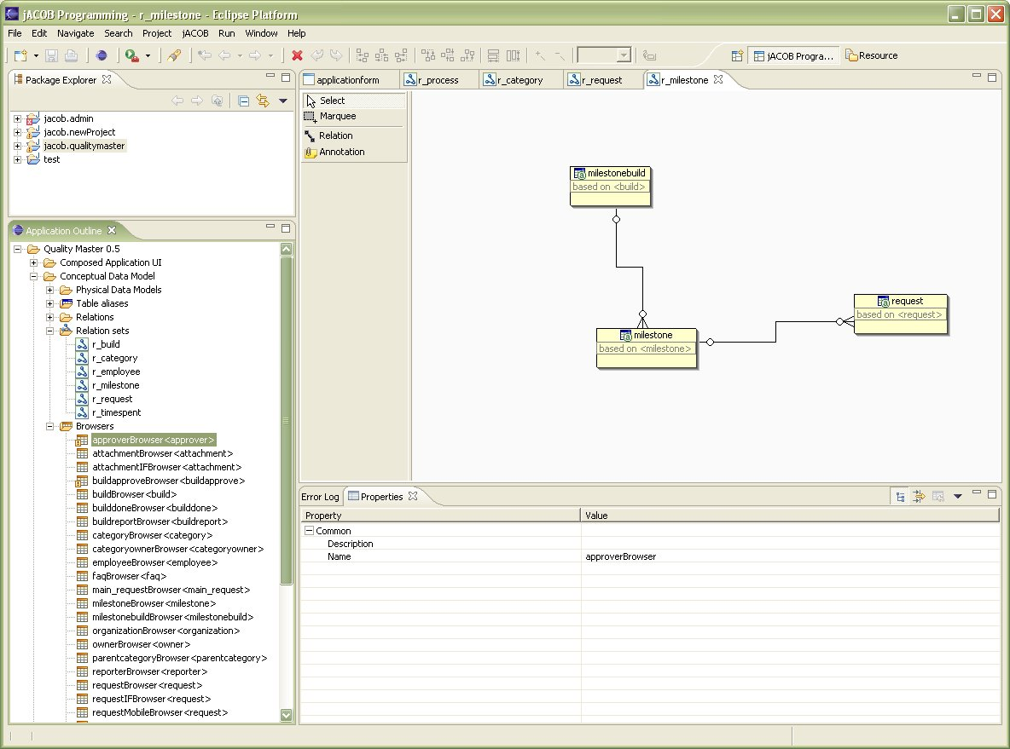
jACOB Designer 1 (Introduction)
Based on best of breed Eclipse
Java development environment.
Powerful editors to create application
screens and data structures.
Full debugging functionality of jACOB
applications running in remote
environment (Tomcat).
Maintenance of different, separated
jACOB application projects.
Ready to go wizards to create
new jACOB application projects for
different purposes.

Slide 25
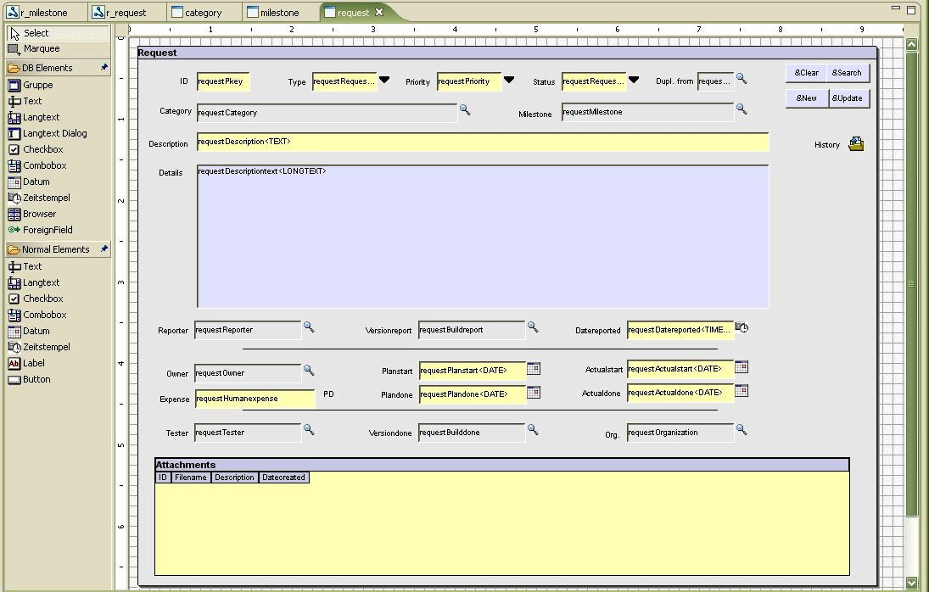
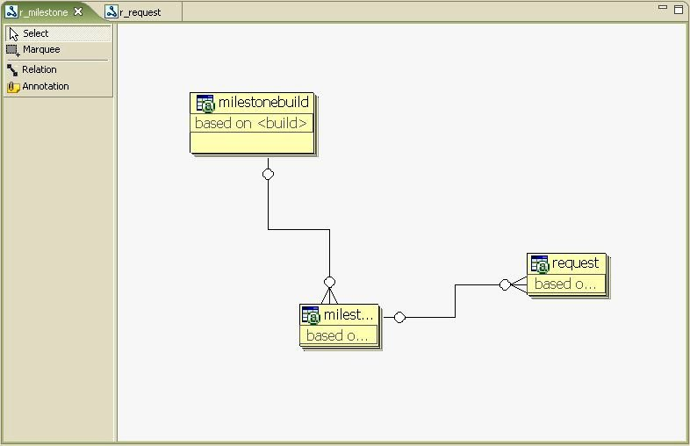
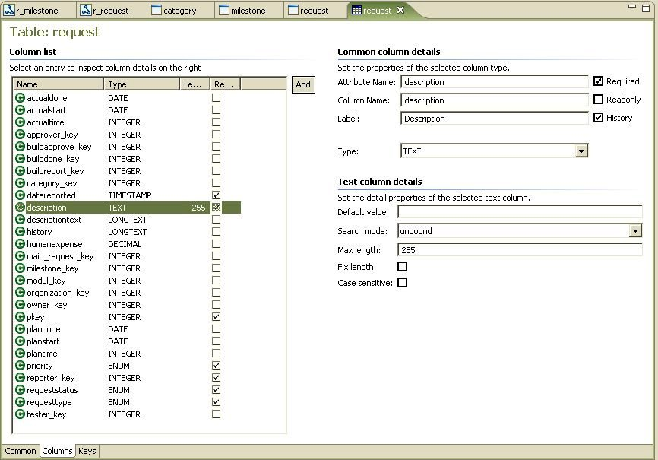
jACOB Designer 2 (Editors)
Graphical screen editors with drag&drop
functionality and powerful editing tools
like guards for keeping elements in line.
“Jump to Java hook” functionality out
off all editors, i.e. to easily glue business
logic to screen and data elements.
Graphical relation/relationset editors
with drag&drop functionality and test
mode to inspect result in screen editors.
Editors for tables, fields and keys with the
ability to reverse engineer already existing
databases.

Slide 26
Multilanguage Support and Internationalization
jACOB Core Engine:
Generation of multilanguage core messages by means of localized resource bundles and depending on the user’s preferred language.
Support of different number and datetime formats.
jACOB Applications:
Application developer decides whether an application should be internationalized or not.
jACOB designer provides the following techniques: Editor for localized resource bundles used for screen labels and messages created by application hooks; test functionality to check screens for different languages; determination of a user’s preferred language by means of extendable user management.

Slide 27
Roadmap
Customer
User
Interface
Email-Management
SelfHelp
Document
Management
Core Engine
&
Runtime
Designer
(Applications with
jACOB Designer)
Workflow
Content
Management
Ad-hoc
ReportWriter

